Slide 1



Chesu no Kai!
By devTech
GLA University
B.Tech CS
07-05-2024

Slide 2


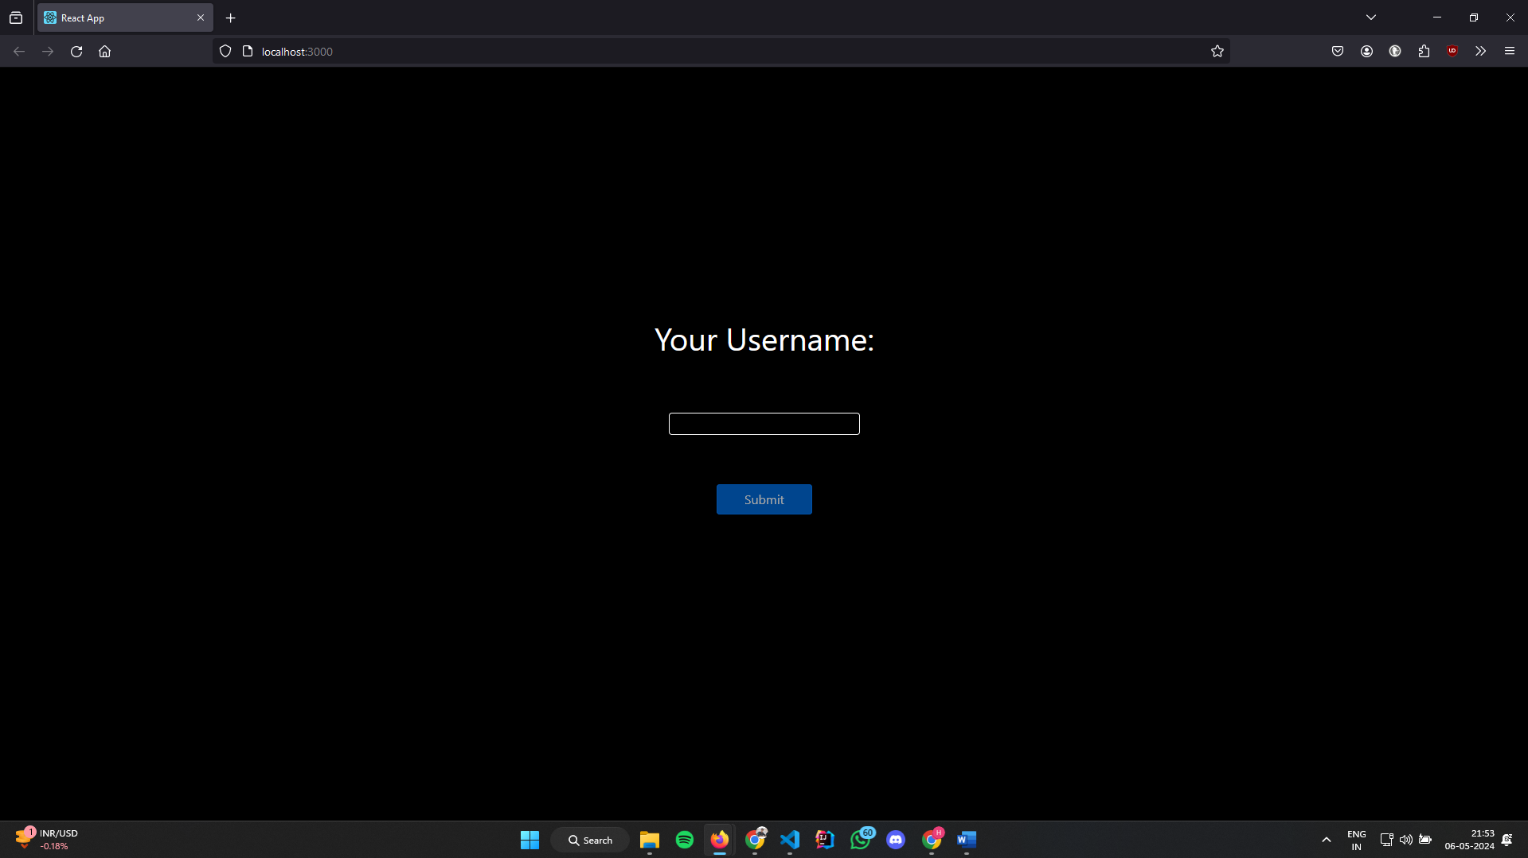
Introduction
Welcome to our presentation on the Multiplayer Chess Game, a revolutionary platform built to connect players from across the globe in the timeless game of chess. Harnessing the power of modern web technologies such as React, Node.js, and webRTC, our platform offers an immersive and seamless gaming experience like never before.

Slide 3
Objectives
Develop a multiplayer chess game that allows users to play anonymously via unique links.
Implement real-time communication features using webRTC for in-game chat.
Create an intuitive user interface for seamless gameplay experience.
Ensure cross-platform compatibility for accessibility on various devices.
Establish a robust backend infrastructure to handle game logic and real-time updates.

Slide 4
Problem Statement
Traditional chess platforms lack seamless multiplayer functionality and real-time communication features.
Existing solutions often require user registration and lack anonymity, hindering spontaneous gameplay.
Limited cross-platform compatibility restricts accessibility for users on different devices.
There is a need for a modern, user-friendly chess platform that addresses these limitations and provides a truly immersive gaming experience.

Slide 5
Literature Review
Explore existing multiplayer chess platforms and their features.
Review literature on webRTC technology and its application in real-time communication.
Examine methodologies and technologies used in similar gaming projects for insights and best practices.

Slide 6
Methodology
Utilize Agile development methodologies for iterative and incremental software development.
Employ React for front-end development to create a dynamic and responsive user interface.
Implement Node.js with Express for the backend to handle game logic and communication.
Integrate webRTC for real-time audio and video communication between players.
Utilize Socket.io for real-time updates and synchronization between players.

Slide 7
System Architecture
Client-side architecture built with React for the user interface and webRTC for real-time communication.
Server-side architecture implemented using Node.js and Express to handle game logic and communication.
Integration of Socket.io for bidirectional communication between the client and server.
Database management (if applicable) for user authentication and game data storage.

Slide 8
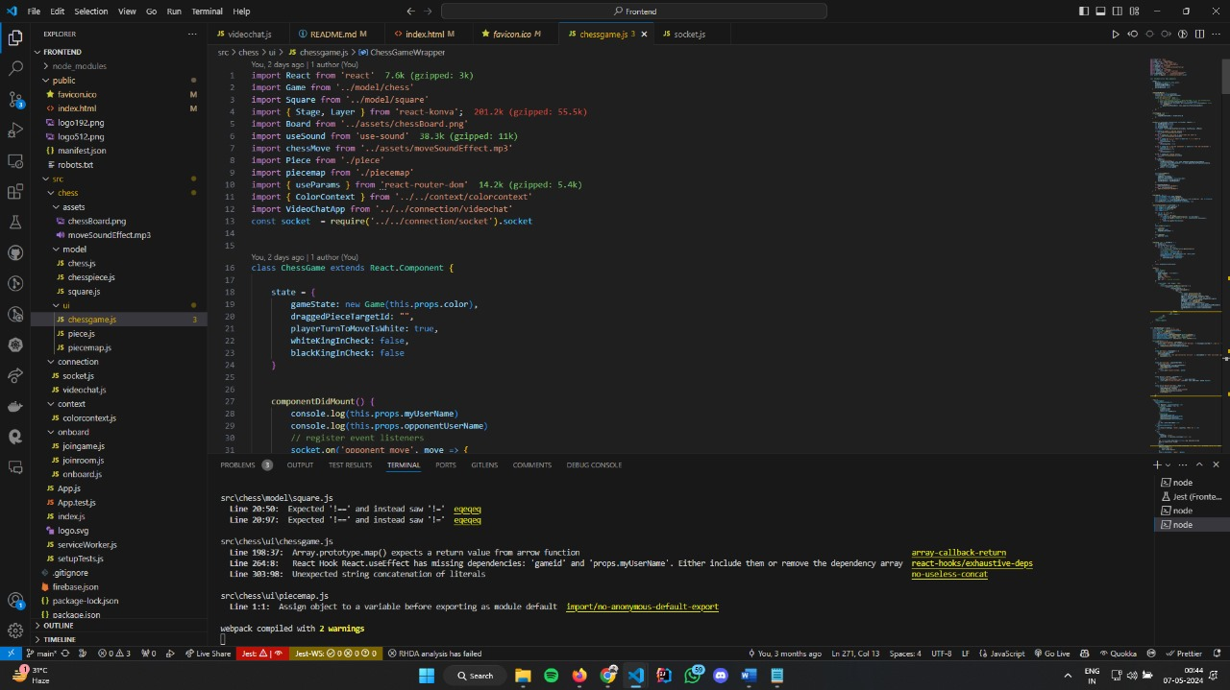
Implementation
Detailed overview of the development process, including frontend and backend components.
Integration of webRTC for real-time communication and Socket.io for synchronization.
Implementation of game logic, user authentication, and anonymous gameplay via unique links.
Testing procedures and debugging techniques to ensure functionality and performance.

Slide 9
Features
Anonymous gameplay via unique links for spontaneous challenges.
Real-time chat functionality using webRTC for in-game communication.
Cross-platform compatibility accessible through web browsers on desktop and mobile devices.
Intuitive user interface designed with React for seamless navigation and gameplay.
Robust backend infrastructure powered by Node.js and Express for reliable performance.

Slide 10
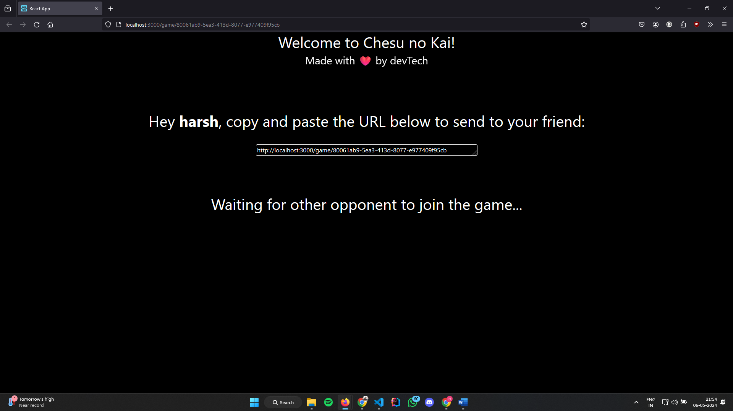
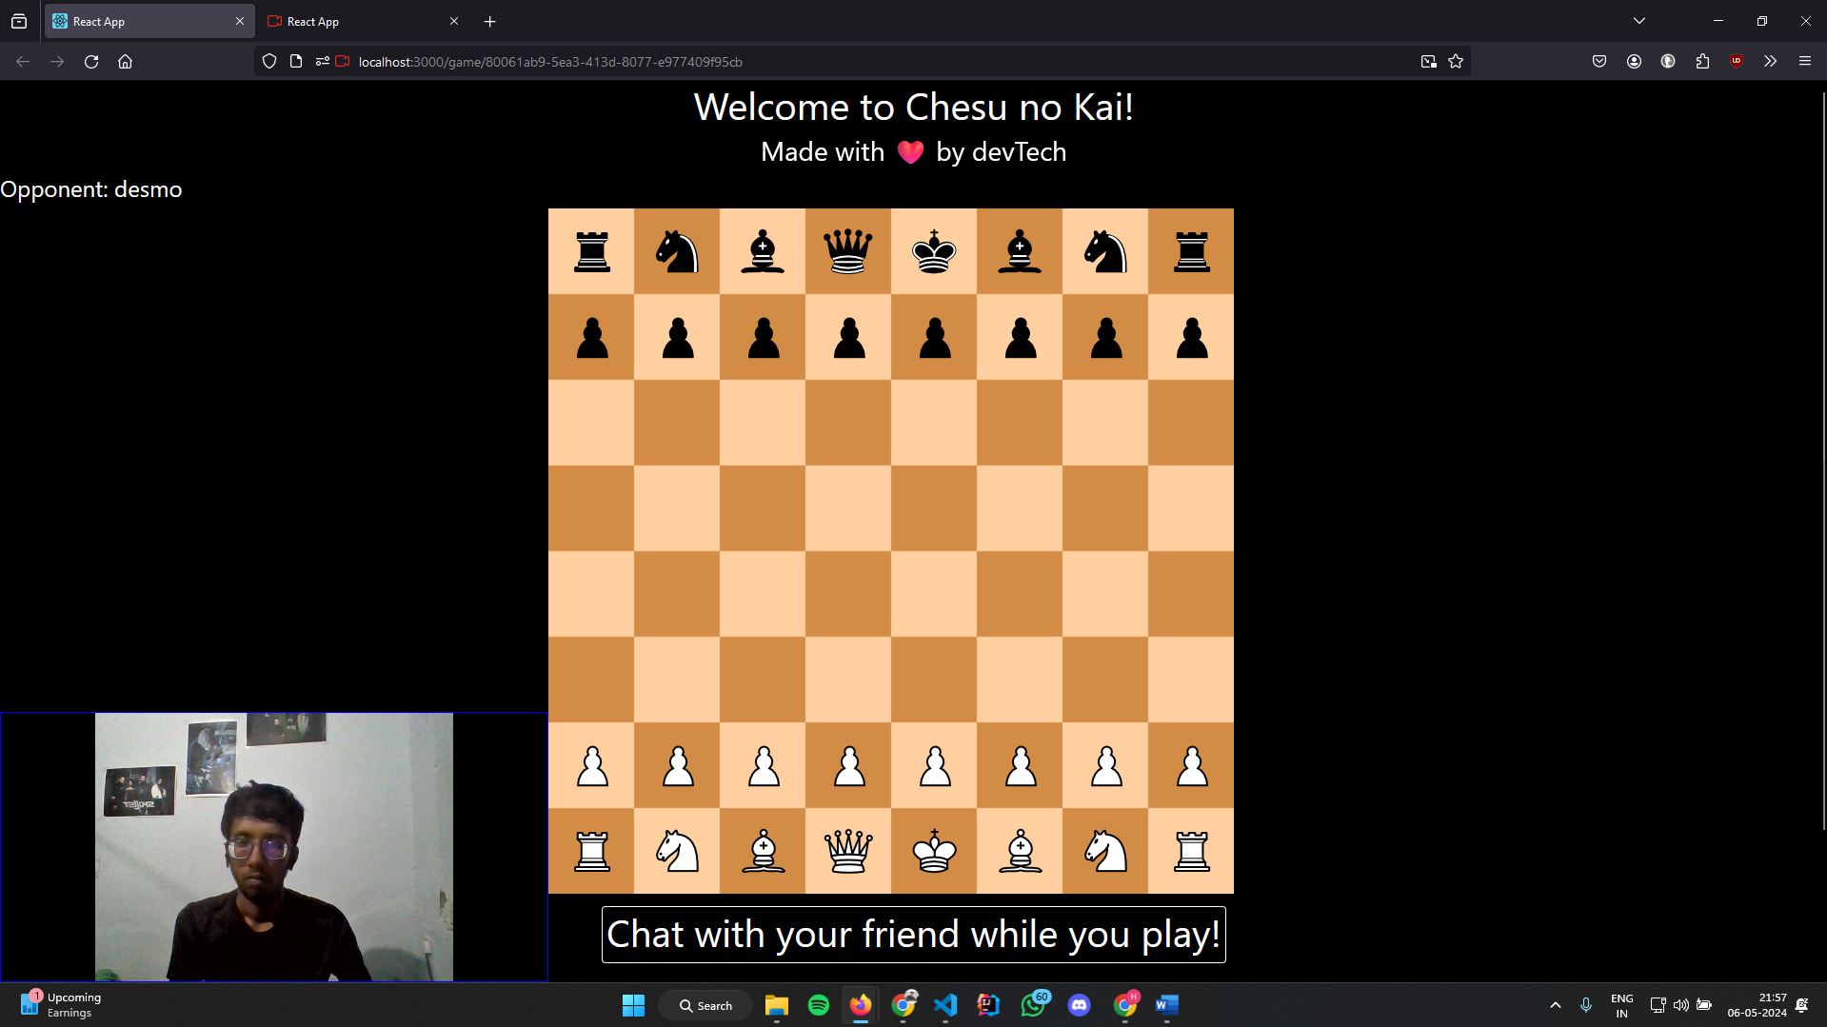
Results

Slide 11
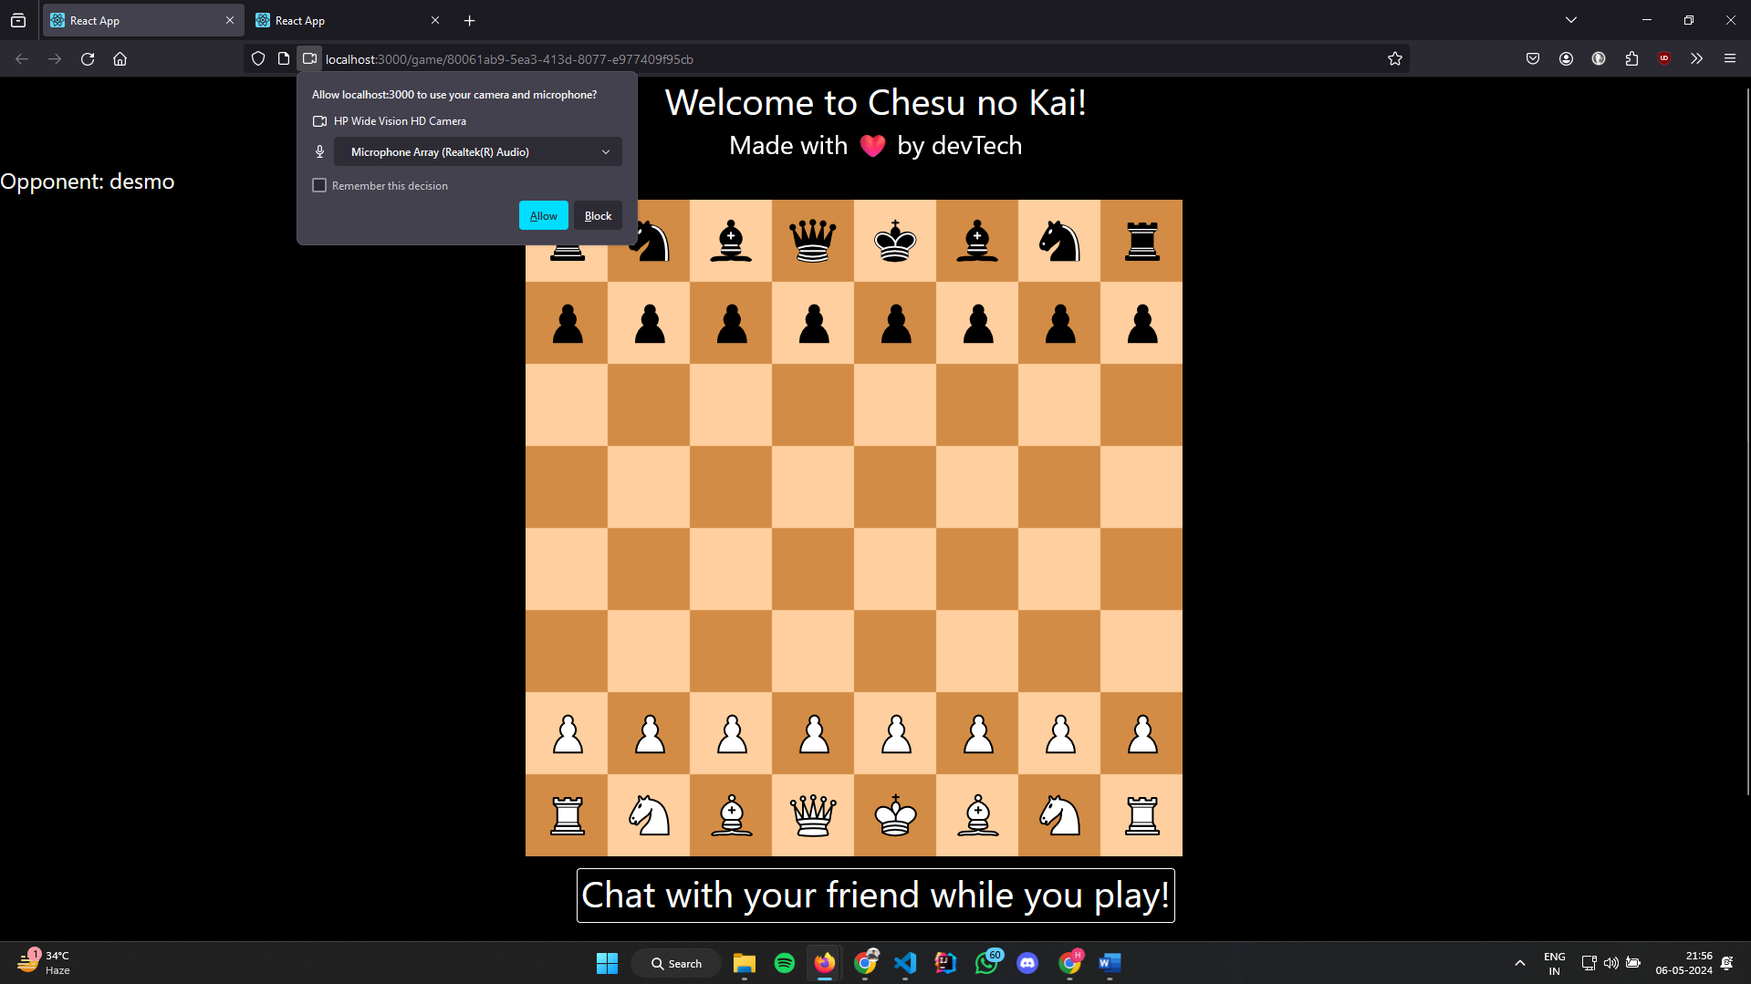
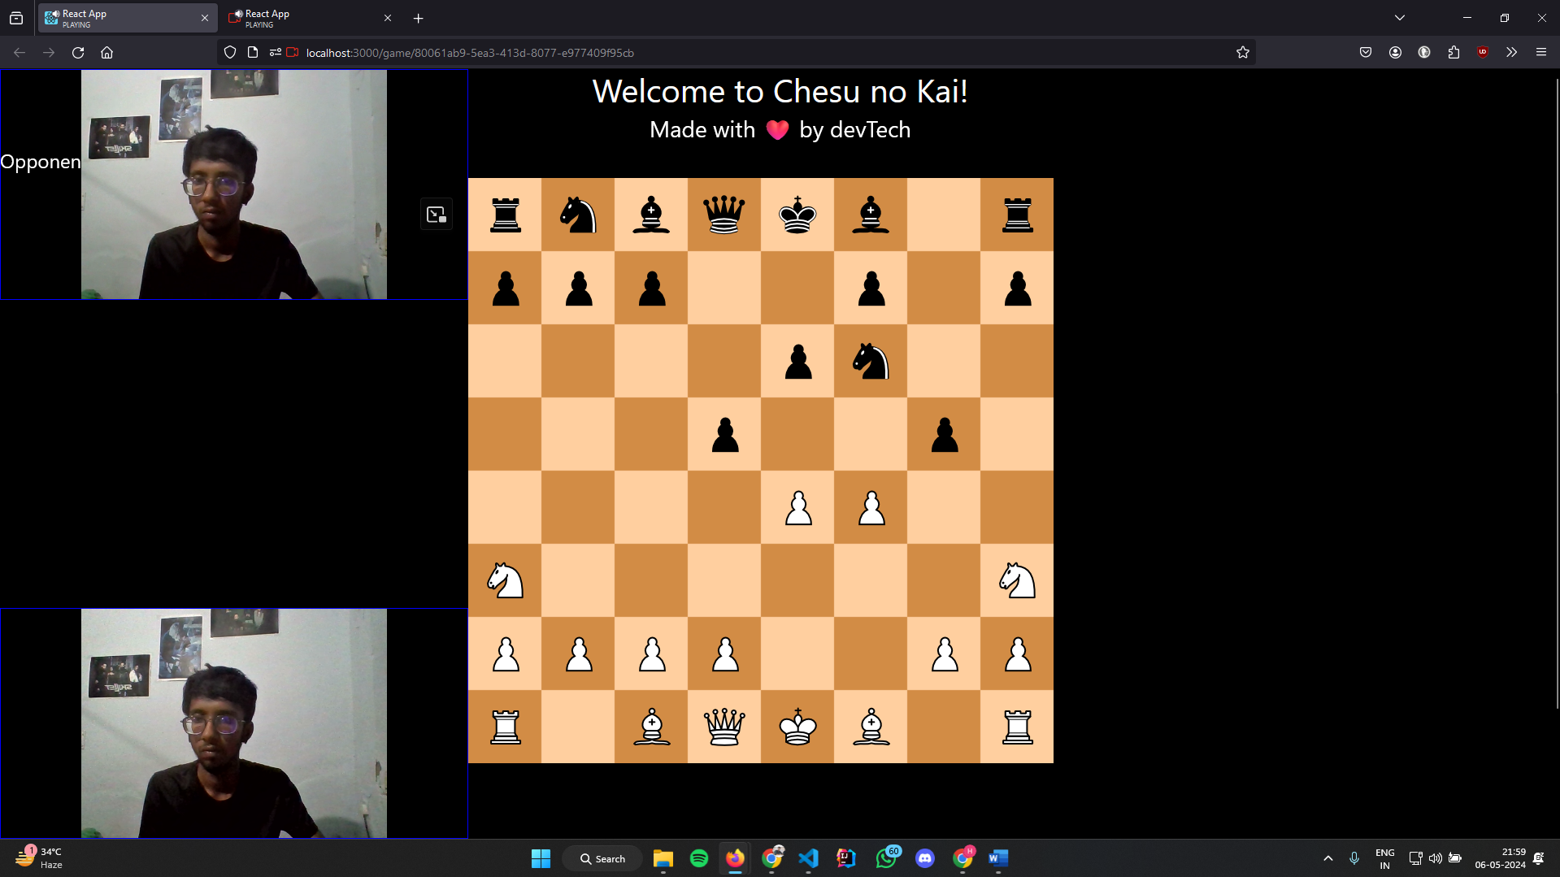

Slide 12
Challenges Faced
Overcoming technical challenges in implementing real-time communication features with webRTC.
Ensuring seamless synchronization and updates between players using Socket.io.
Addressing cross-platform compatibility issues for optimal user experience.
Optimizing performance and scalability of the backend infrastructure to handle multiple concurrent game sessions.

Slide 13
Future Work
Implement additional features such as player rankings, tournaments, and social sharing.
Enhance user experience with AI opponents for single-player mode.
Explore integration with external APIs for advanced analytics and insights.
Continuously optimize performance and scalability based on user feedback and usage patterns.

Slide 14
Conclusion
Recap of key achievements and milestones in developing the Multiplayer Chess Game. Highlight the significance of addressing the identified problem statement and achieving project objectives. Emphasize the impact of the platform in providing a seamless and immersive gaming experience for users worldwide.

Slide 15
Acknowledgment
Recognition of team members, mentors, and contributors who contributed to the success of the project.
Appreciation for the support and guidance received throughout the development process.
Gratitude towards users and testers for their valuable feedback and suggestions.

Slide 16
Q & A

